Slide 1


Here's your outline to get started
Key facts about your topic
Bangalore, officially known as Bengaluru, is the capital city of the Indian state of Karnataka. It has a population of over ten million, making it a megacity and the third most populous city and fifth most populous urban agglomeration in India. It is located in southern India on the Deccan Plateau at an elevation of over 900 m above sea level, which is the highest among India's major cities. It reflects its multireligious and cosmopolitan character by its more than 1000 temples, 400 mosques, 100 churches, 40 Jain derasars, three Sikhgurdwaras, two Buddhist viharas and one Parsi fire ...
Local time: India Standard Time
Population: 12.34 Million (2017)
Area: 286.10 sq miles (741 km²)
State: Karnataka
Colleges and universities: Bangalore University, Indian Institute of Science, Christ University, T John Institute Of Management & Science...
Mayor: Gangambike Mallikarjun
Location: 12.96697°N 77.58728°E
See more: Open the Notes below for more information.
Notes:
QuickStarter has created an outline to help you get started on your presentation. Some slides include information here in the notes to provide additional topics for you to research.
Summary:
Bangalore, officially known as Bengaluru, is the capital city of the Indian state of Karnataka. It has a population of over ten million, making it a megacity and the third most populous city and fifth most populous urban agglomeration in India. It is located in southern India on the Deccan Plateau at an elevation of over 900 m above sea level, which is the highest among India's major cities. It reflects its multireligious and cosmopolitan character by its more than 1000 temples, 400 mosques, 100 churches, 40 Jain derasars, three Sikhgurdwaras, two Buddhist viharas and one Parsi fire temple located in an area of 741 km² of the metropolis. The religious places are further represented to include the few members of the Jewish community who are making their presence known through the Chabad that they propose to establish in Bengaluru and the fairly large number of Bahá'ís whose presence is registered with a society called the Bahá'í Centre.
More key facts:
Colleges and universities: Bangalore University, Indian Institute of Science, Christ University, T John Institute Of Management & Science, Bangalore Institute of Technology, International Institute of Information Technology, Bangalore, Bangalore Medical College and Research Institute, National Law School of India University, Indian Institute of Management Bangalore, Rajiv Gandhi University of Health Sciences, R.V. College of Engineering, Ramaiah Institute of Technology, Al-Ameen College of Law, National Centre for Biological Sciences, University Visvesvaraya College of Engineering, University of Agricultural Sciences, Bangalore, B.M.S. College of Engineering, Raman Research Institute, Acharya Institute of Technology, Indian Institute of Astrophysics, United Theological College, Bangalore, PES University, Jain University, Vydehi Institute of Medical Sciences & Research Centre, Kempegowda Institute of Medical Sciences, Dayananda Sagar College of Engineering, Sri Venkateswara College of Engineering, South Asia Institute of Advanced Christian Studies, Alliance University, St. Joseph's College of Commerce, Kristu Jayanti College, Xavier Institute of Management and Entrepreneurship, New Horizon College of Engineering, CMR Institute of Technology, Srishti School of Art Design and Technology, Azim Premji University, ISBR Business School, Dr. Ambedkar Institute of Technology, Sir M. Visvesvaraya Institute of Technology, T John Institute of Technology, JSSATE, MVJ College of Engineering, RNS Institute of Technology, BMS Institute of Technology and Management, Sri Jayadeva Institute of Cardiology, Presidency College, Bangalore, The Oxford College of Engineering, KLE Society's Law College, Don Bosco Institute of Technology, Bangalore, B.N.M. Institute of Technology

Slide 2
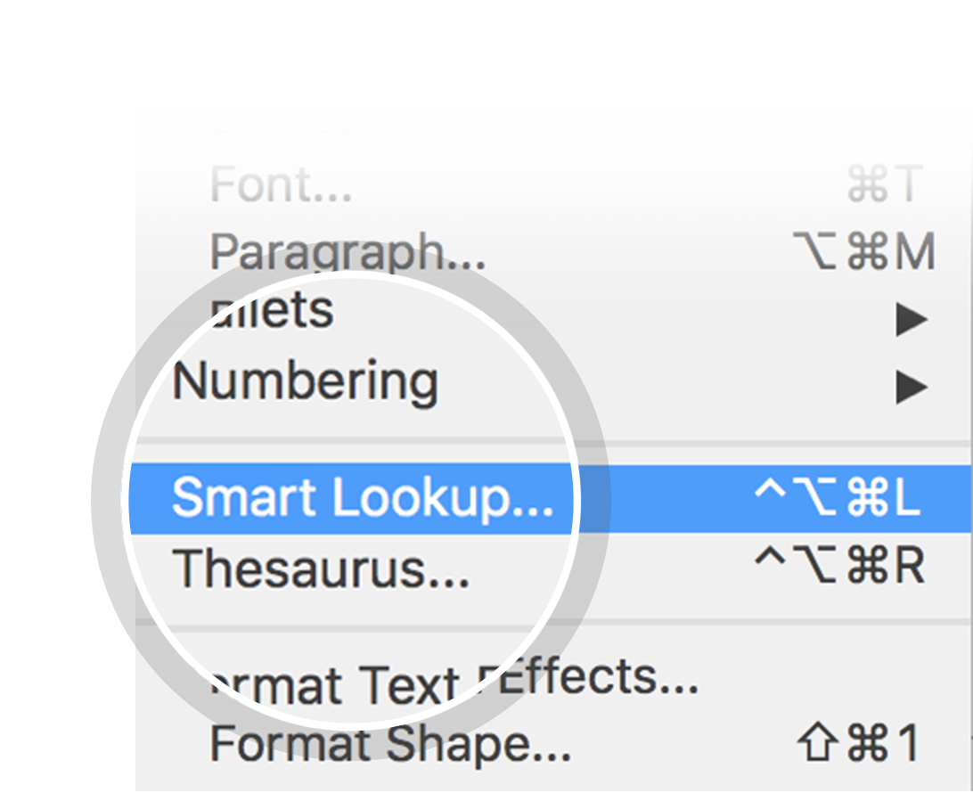
Related topics to research
Karnataka
India
Kempegowda International Airport
Kerala
Infosys
Kannada
Tamil Nadu
Maharashtra
Goa
Andhra Pradesh
Use Smart Lookup to learn more
1
Highlight one of the related topics
Right-click on the topic
Choose "Smart Lookup"
2
3

Slide 3
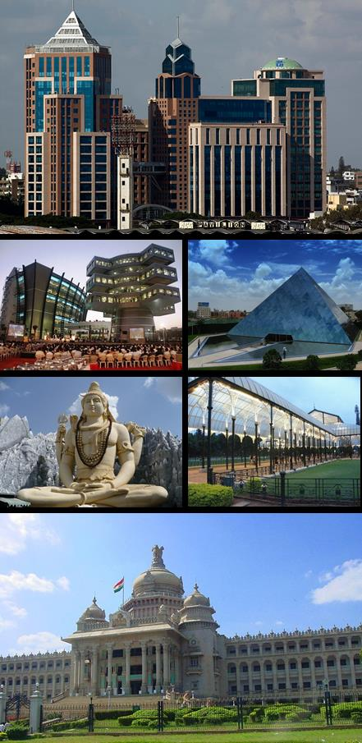
Bengaluru
Facebook – Thoughtworks Hackathon

Slide 4
Contents
Problem Statement
Usecase 1
Usecase 2
Usecase 3

Slide 5
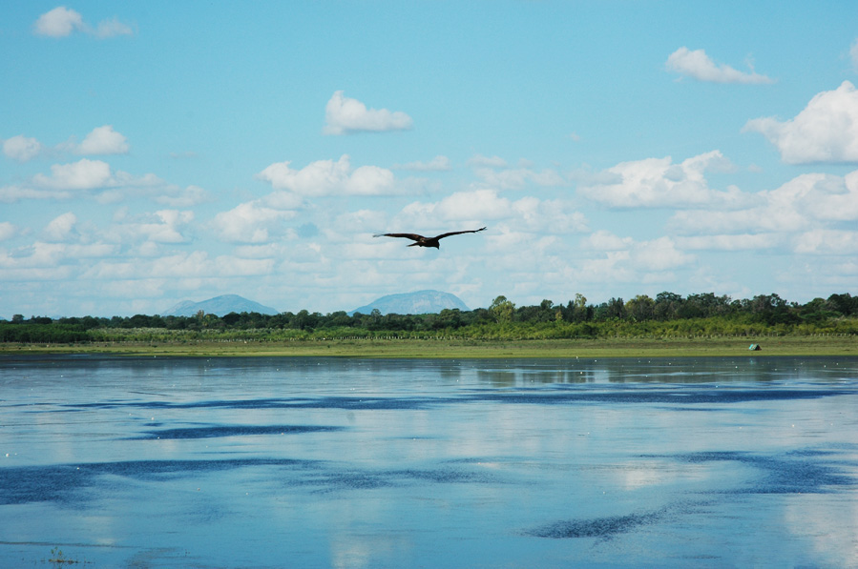
Problem statement : Optimizing Travel time
Our Solution :
Recommendation Engine for Optimizing Office commute
Notes:
Consider talking about:
Climate

Slide 6
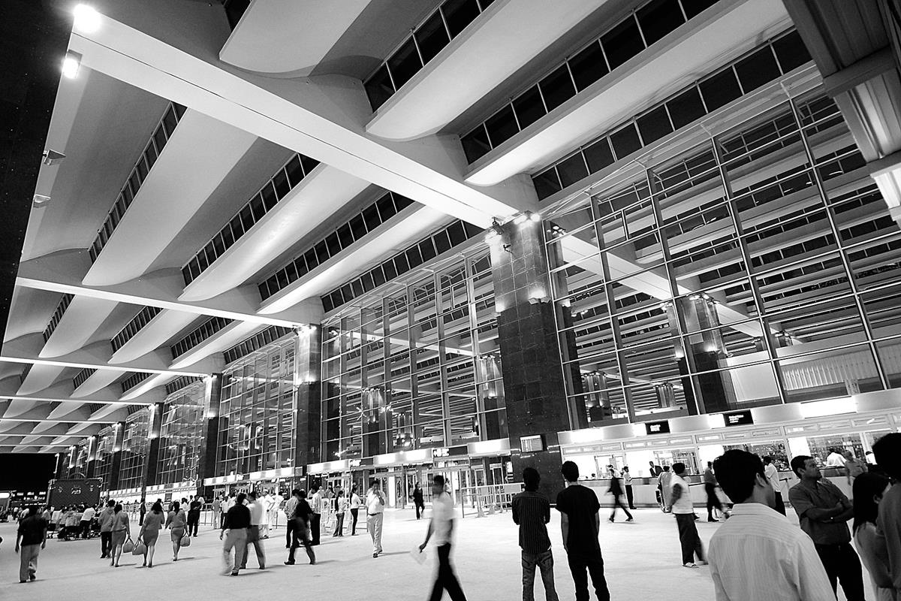
Use Case 1 Recommendation Engine for Optimizing Office Commute
1) Home & Office are stored in favorites
2) From historical data, we know the average time taken to go from Vijayanagar (110 origin id) & Whitefield (169 origin id) (Travel times , wards datasets)
3) We have data for 5 different time segments of a day (early morning, AM peak, midday, evening, PM peak) (Travel times daily dataset)
4) We have historical data for travel time for every day of the week (travel time day of the week dataset)
5) From all the above data, we will create a recommendation engine, which will give 3 recommendations for starting the journey. (Recommendation will be available from previous night, as a message, so the lady can plan her next day’s travel start time)
Notes:
Consider talking about:
Air
Namma Metro (Rail)
Road

Slide 7
Use Case 2 Fastest route Vs Safe Zone route 1
Notifying safe zones on the chosen path, & alternate path (costly path) with more safe zone coverage
e.g. Fastest route – 90 mins to cover 20 kms
Safest route – 105 minutes to cover 20 kms
Notes:
Consider talking about:
Air
Namma Metro (Rail)
Road

Slide 8
Use case 3 – Alternate Transport
Giving alternate routing solution with a mix of public and private transport including last mile connectivity
e.g. origin – auto 2 kms – metro 18 kms – rental cycle pod to office 2 kms.
Using this Solution mix, you reach destination in 100 minutes
Notes:
Consider talking about:
Air
Namma Metro (Rail)
Road

Slide 9
Thanks

